Slide 1
Database Implementation -
SQL

Slide 2
SQL for Data Manipulation
Manipulation
SQL allows a user or an application program to update the database by adding new data, removing old data, and modifying previously stored data.
Retrieval
SQL allows a user or an application program to retrieve stored data from the database and use it.
Most Commonly Used Commands
  SELECT INSERT
  UPDATE DELETE

Slide 3
SQL for Data Manipulation
- High-level Language for data manipulation
- It does not require predefined navigation path
- It does not require knowledge of any key items
- It is uniform language for end-users and programmers
- It operates on one or more tables based on set theory, not on a record at a time.

Slide 4
Command: SELECT
Function:
  Retrieves data from one or more rows. Every SELECT statement produces a table of query results containing one or more columns and zero or more rows.
SELECT [ ALL | DISTINCT ] [ TOP (top_value) [ PERCENT ] [ WITH TIES ] ] expressions
FROM tables
[WHERE conditions] [GROUP BY expressions] [HAVING condition] [ORDER BY expression [ ASC | DESC ]];

Slide 5
Parameters or Arguments
ALL Optional. Returns all matching rows.
DISTINCT Optional. Removes duplicates from the result set.
TOP (top_value)Optional. If specified, it will return the top number of rows in the result set based on top_value. For example, TOP(10) would return the top 10 rows from the full result set.
PERCENT Optional. If specified, then the top rows are based on a percentage of the total result set (as specfied by the top_value). For example, TOP(10) PERCENT would return the top 10% of the full result set.
WITH TIES Optional. If specified, then rows tied in last place within the limited result set are returned. This may result in more rows be returned than the TOP parameter permits.
Expressions The columns or calculations that you wish to retrieve. Use * if you wish to select all columns.
Tables The tables that you wish to retrieve records from. There must be at least one table listed in the FROM clause.
WHERE conditions Optional. The conditions that must be met for the records to be selected.

Slide 6
GROUP BY expressions Optional. It collects data across multiple records and groups the results by one or more columns.
HAVING condition Optional. It is used in combination with the GROUP BY to restrict the groups of returned rows to only those whose the condition is TRUE.
ORDER BY expression Optional. It is used to sort the records in your result set. ASC sorts in ascending order and DESC sorts in descending order.

Slide 7
Employee
E-No E-Name D-No
179 Silva 7
857 Perera 4
342 Dias 7

Slide 8
Project Selected Columns
Employee
Employee Names
E-No E-Name D-No
179 Silva 7
857 Perera 4
342 Dias 7
E-No E-Name
179 Silva
857 Perera
342 Dias
SELECT E-No, E-Name
FROM Employee ;
Employee Names
E-No E-Name
342 Dias
857 Perera
179 Silva
SELECT E-No, E-Name
FROM Employee
ORDER BY E-Name ;

Slide 9
Restrict Rows
Employee
Sales Employee
E-No E-Name D-No
179 Silva 7
857 Perera 4
342 Dias 7
E-No E-Name D-No
179 Silva 7
342 Dias 7
SELECT *
FROM Employee WHERE D-No = '7' ;
Sales Employee
E-No E-Name
179 Silva
342 Dias
SELECT E-No, E-Name
FROM Employee WHERE D-No = '7' ;
Restrict Rows and Project Columns

Slide 10
FROM Clause
Syntax
The syntax for the FROM clause in SQL Server (Transact-SQL) is:
FROM table1
[,table2]
[ { INNER JOIN
| LEFT OUTER JOIN
| RIGHT OUTER JOIN
| FULL OUTER JOIN } table2
ON table1.column1 = table2.column1 ]

Slide 11
Employee
EquiJoin
Department
E-No E-Name D-No
179 Silva 7
857 Perera 4
342 Dias 7
D-No D-Name M-No
4 Finance 857
7 Sales 179
Emp-Info
E-No E-Name D-No D-No D-Name M-No
179 Silva 7 7 Sales 179
857 Perera 4 4 Finance 857
342 Dias 7 7 Sales 179
SELECT Employee.*, Department.*
FROM Employee, Department
WHERE Employee.D-No = Department.D-No ;
SELECT E.*, D.*
FROM Employee E, Department D
WHERE E.D-No = D.D-No ;

Slide 12
Cartesian Product
Employee
Department
E-No E-Name D-No
179 Silva 7
857 Perera 4
342 Dias 7
D-No D-Name M-No
4 Finance 857
7 Sales 179
Emp-Info
E-No E-Name D-No D-No D-Name M-No
179 Silva 7 4 Finance 857
857 Perera 4 4 Finance 857
342 Dias 7 4 Finance 857
179 Silva 7 7 Sales 179
857 Perera 4 7 Sales 179
342 Dias 7 7 Sales 179
SELECT E.*, D.*
FROM Employee E, Department D

Slide 13
SQL Data Retrieval
Basic Search Conditions:
Comparison
  Equal to =
  Not equal to != or <> or ^=
  Less than to <
  Less than or equal to <=
  Greater than to >
  Greater than or equal to >=

Slide 14
SQL Data Retrieval
Basic Search Conditions (cont’d) :
Range ( [NOT] BETWEEN)
  expres-1 [NOT] BETWEEN expres-2 AND expres- 3
  Example: WEIGHT BETWEEN 50 AND 60
Set Membership ( [NOT] IN)
  Example 1: WHERE Emp_No IN (‘E1’, ‘E2’, ‘E3’)
  Example 2: WHERE Emp_No IN (Select Emp_No FROM Employee WHERE Dept_No=‘7’)

Slide 15
Basic Search Conditions (cont’d) :
Pattern Matching ([NOT] LIKE)
  expres-1 [NOT] LIKE {special-register | host-variable | string-constant}
  Example: WHERE Proj_Name LIKE “INFORM%”
Null Value (IS [NOT] NULL)
  Example: WHERE Proj_Name IS NOT NULL
AND, OR and NOT
Compound Search Conditions :
Example:
WHERE Proj_Name LIKE ‘INFORM%’ AND Emp_Name = ‘DIAS’

Slide 16
SQL Query Features
Summary Queries
  Summarize data from the database. In general, summary queries use SQL functions to collapse a column of data values into a single value that summarizes the column. (AVG, MIN, MAX, SUM, COUNT..)
Sub-Queries
  Use the results of one query to help define another query

Slide 17
Summarising Data
SELECT COUNT(*)
FROM Employee
Employee
E-No Job Salary D-No
179 Manager 20000 10
857 Clerk 8000 10
342 Clerk 9000 20
477 Manager 15000 30
432 Clerk 10000 30
Count(*)
5
    SELECT AVG(Salary)
    FROM Employee
AVG(Salary)
12400

Slide 18
SELECT STATEMENT
May also contain
[GROUP BY [HAVING] ORDER BY]
GROUP BY
A result of a previous specified clause is grouped using the group
by clause.
e.g. SELECT d-no, AVG(salary)
FROM employee
GROUP BY d-no
Employee
E-No Job Salary D-No
179 Manager 20000 10
857 Clerk 8000 10
342 Clerk 9000 20
477 Manager 15000 30
432 Clerk 10000 30
D-No AVG(Salary)
10 14,000
20 9,000
30 12,500

Slide 19
[GROUP BY [HAVING] ORDER BY]
HAVING
Used for select groups that meet specified conditions.
Always used with GROUP BY clause.
    SELECT d-no, AVG(salary)
    FORM employee
    GROUP BY d-no
    HAVING AVG(salary)>12000
Employee
E-No Job Salary D-No
179 Manager 20000 10
857 Clerk 8000 10
342 Clerk 9000 20
477 Manager 15000 30
432 Clerk 10000 30
D-No AVG(Salary)
10 14,000
30 12,500

Slide 20
Nested Queries
A sub query is SELECT statement that nest inside the WHERE
clause of another SELECT statement. The results are need in
solving the main query.
Get a list of all suppliers supplying part P2.
SELECT sname
FROM supplier
WHERE sno IN
(SELECT sno FROM supply WHERE pno = ‘P2’);
SELECT sname
FROM supplier, supply
WHERE supplier.sno = supply.sno and pno = ‘P2’;

Slide 21
Nested Queries
SELECT ename , salary
FROM employee
WHERE salary = (SELECT MIN (salary) FROM employee)
Sub queries with EXISTS
e.g. find all publishers who publish business books
SELECT DISTINCT pub_name
FROM publishers
WHERE EXISTS
(SELECT * FROM title
WHERE pub_id = publishers.pub_id and type = “business”)
DISTINCT – will remove multiple occurrences

Slide 22
Command: INSERT
Function:
  Places data one or more rows into a table
  Data can also be downloaded from another computer system or collected from other sites.
INSERT Command
INSERT INTO table-name (column-name,),
    | VALUES ([constant, NULL],)
    or
    | SELECT retrieval condition

Slide 23
Command: INSERT (cont’d)
   Single-Row Insert
    INSERT INTO Employee (Emp_No, Emp_Name, Age, Dept)
    VALUES (‘E1’, ‘Dias’, 26, ‘PER’)
     Multi-Row Insert
    INSERT INTO Manager (Emp_No, Emp_Name, Age, Dept)
    SELECT Emp_No, Emp_Name, Age, Dept
    FROM Employee
    WHERE Job = ‘Manager’

Slide 24
RESTRICT INSERT
Insert with referential integrity
In Employee Table
CONSTRAINT Emp_Dep_FK
FOREIGN KEY (Dept) REFERENCES Department(Dept_Code)
INSERT INTO Employee
VALUES (342, ‘Dias, 26, ‘Sale’);
An employee can only be inserted if its department is found in department table

Slide 25
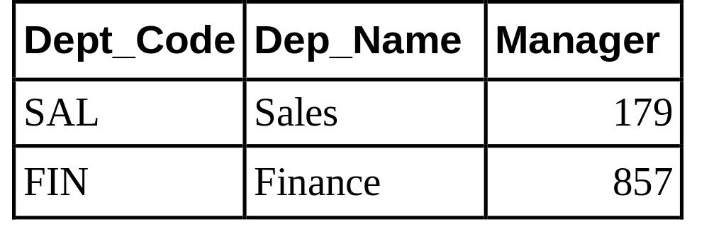
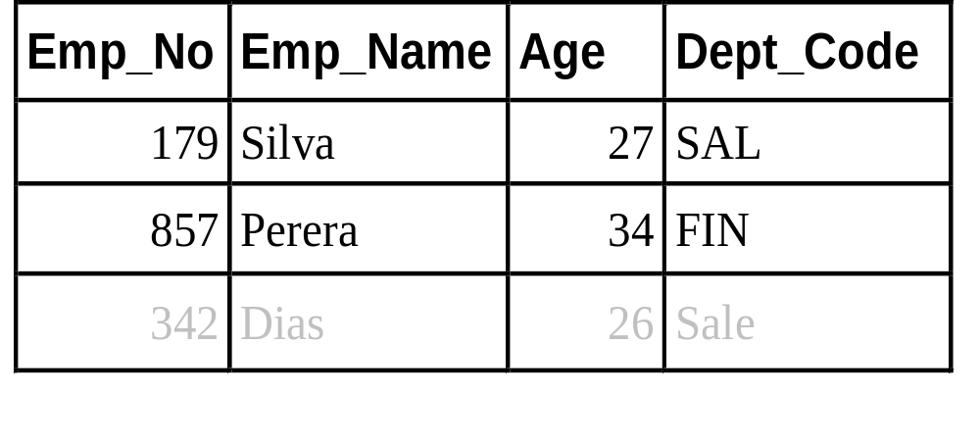
RESTRICT INSERT
Department
Employee
×

Slide 26
Command: UPDATE
Function: Changes data in one or more rows of a table
UPDATE table-name
    SET (column-name = expression,),
    WHERE search-condition
Example:
UPDATE STUDCLASS
SET FEES = 1200
WHERE STUDNO = 1234
Selective Update
UPDATE STUDCLASS
SET FEES = 1200
Update All Rows

Slide 27
Command: UPDATE (cont’d)
Example:
Update with Subquery
UPDATE Works_On
SET Hours = 12
WHERE Proj_No IN(SELECT Proj_No FROM Project
WHERE Proj_Name = ‘INFORMATION TECHNOLOGY’)
UPDATE Employee
SET Age = Age+1

Slide 28
RESTRICT UPDATE
Update with referential integrity
In Employee Table
CONSTRAINT Emp_Dep_FK
FOREIGN KEY (Dept) REFERENCES Department(Dept_Code) ON UPDATE RESTRICT
UPDATE Department SET Dept_Code = ‘Sale’
WHERE Dept_Code = ‘SAL’
A department code can only be changed if it is not found in employee table (i.e. no employees working for them)

Slide 29
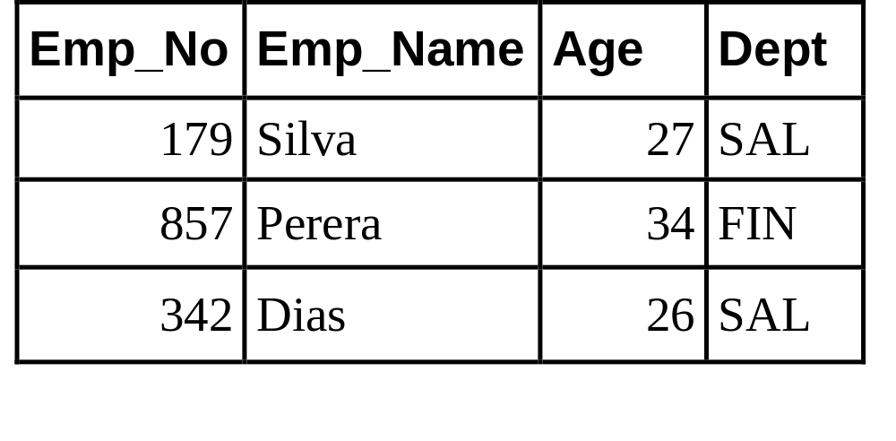
RESTRICT UPDATE
Department
×
Employee

Slide 30
CASCADE UPDATE
Update with referential integrity
In Employee Table
CONSTRAINT Emp_Dep_FK
FOREIGN KEY (Dept) REFERENCES Department(Dept_Code) ON UPDATE CASCADE
UPDATE Department SET Dept_Code = ‘Sale’
WHERE Dept_Code = ‘SAL’
Updating a department code will result in changing it in the employee table (update with new department code for the employees working for them)

Slide 31
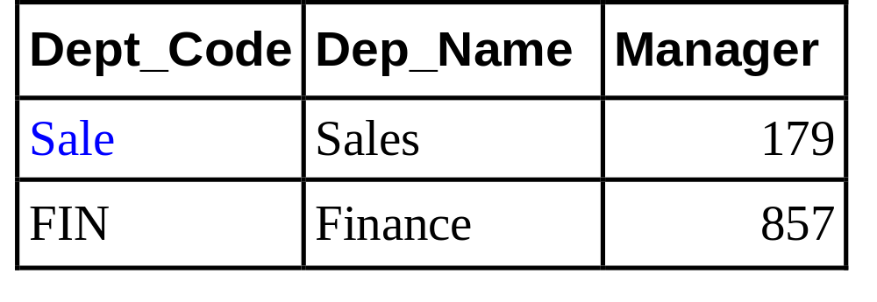
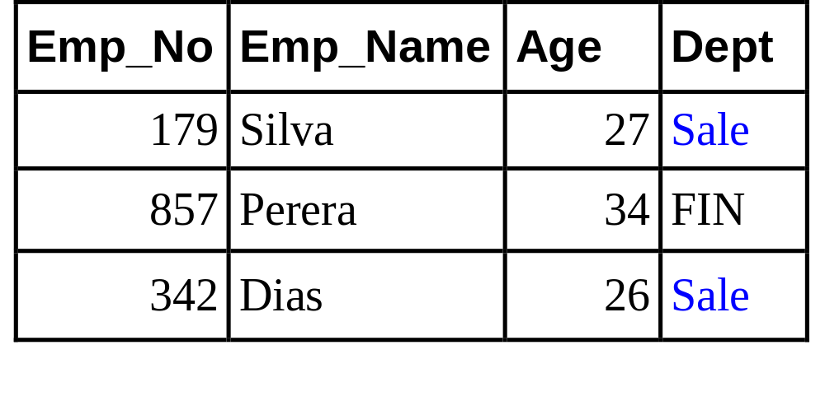
CASCADE UPDATE
Department
Employee

Slide 32
SET NULL UPDATE
Update with referential integrity
In Employee Table
CONSTRAINT Emp_Dep_FK
FOREIGN KEY (Dept) REFERENCES Department(Dept_Code) ON UPDATE SET NULL
UPDATE Department SET Dept_Code = ‘Sale’
WHERE Dept_Code = ‘SAL’
Updating a department code will result in changing the department code of their employees to NULL (only if NULL values are allowed)

Slide 33
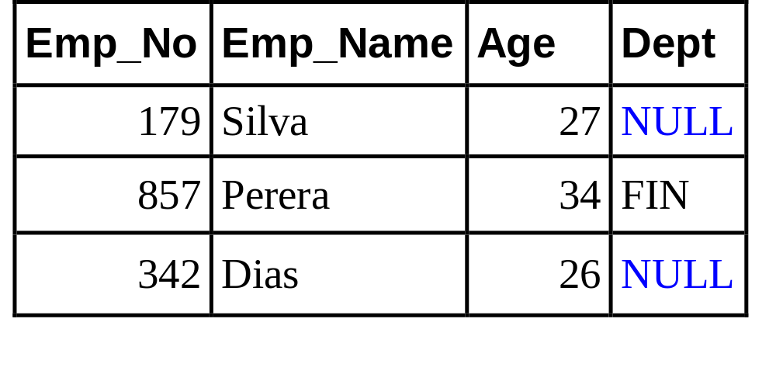
SET NULL UPDATE
Department
Employee

Slide 34
SET DEFAULT UPDATE
Update with referential integrity
In Employee Table
CONSTRAINT Emp_Dep_FK
FOREIGN KEY (Dept) REFERENCES Department(Dept_Code) ON UPDATE
SET DEFAULT ‘AAA’
UPDATE Department SET Dept_Code = ‘Sale’
WHERE Dept_Code = ‘SAL’
Updating a department code will result in changing the department code of their employees to a default value

Slide 35
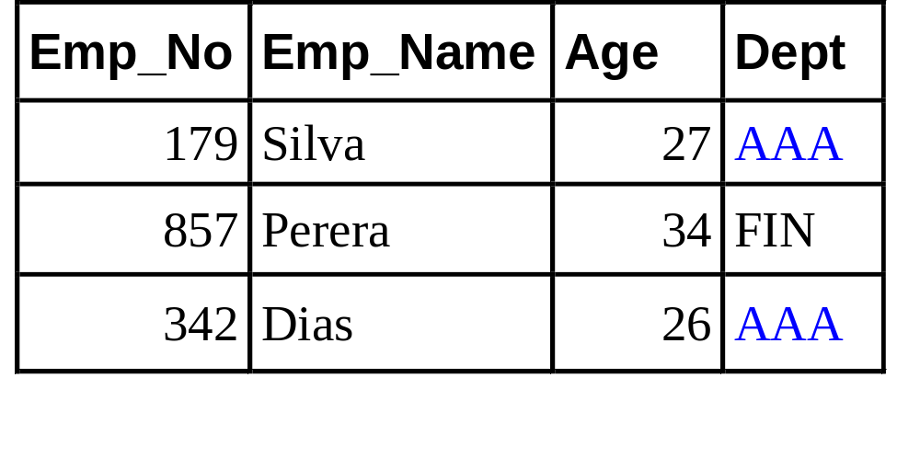
SET DEFAULT UPDATE
Department
Employee

Slide 36
Command: DELETE
Function: Removes one or more rows from a table
DELETE FROM table-name
    {WHERE search-condition}
Example:
DELETE FROM Employee
WHERE Emp_No = ‘E1’
Select Delete
DELETE FROM Employee
Delete All Rows
Delete with Subquery
DELETE FROM Dependent
WHERE Emp_No = (SELECT Emp_No FROM Employee
WHERE Emp_Name = ‘Dias’)

Slide 37
RESTRICT DELETE
Delete with referential integrity
In Employee Table
CONSTRAINT Emp_Dep_FK
FOREIGN KEY (Dept) REFERENCES Department(Dept_Code) ON DELETE RESTRICT
DELETE FROM Department
WHERE Dept_Code = ‘SAL’
A department can only be deleted if it is not found in employee table (i.e. no employees working for them)

Slide 38
RESTRICT DELETE
Department
×
Employee

Slide 39
CASCADE DELETE
Delete with referential integrity
In Employee Table
CONSTRAINT Emp_Dep_FK
FOREIGN KEY (Dept) REFERENCES Department(Dept_Code) ON DELETE CASCADE
DELETE FROM Department
WHERE Dept_Code = ‘SAL’
Deleting a department will result in deleting it from the employee table (delete employees working for them)

Slide 40
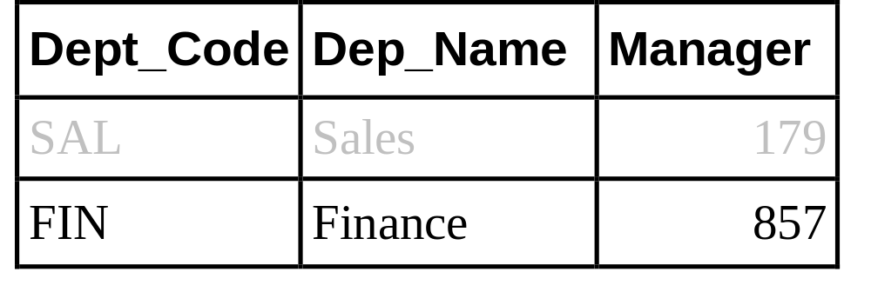
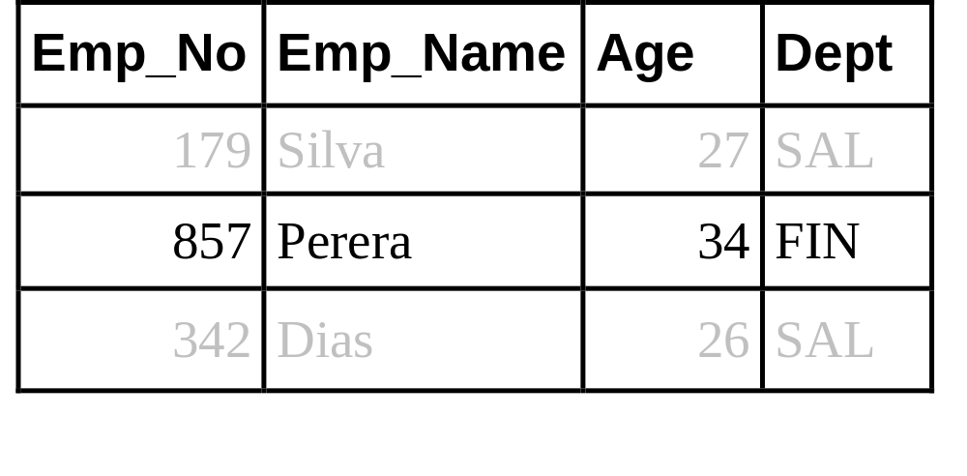
CASCADE DELETE
Department
×
Employee
×
×

Slide 41
SET NULL DELETE
Delete with referential integrity
In Employee Table
CONSTRAINT Emp_Dep_FK
FOREIGN KEY (Dept) REFERENCES Department(Dept_Code) ON DELETE SET NULL
DELETE FROM Department
WHERE Dept_Code = ‘SAL’
Deleting a department will result in changing the department of their employees in the employee table to NULL (only if NULL values are allowed)

Slide 42
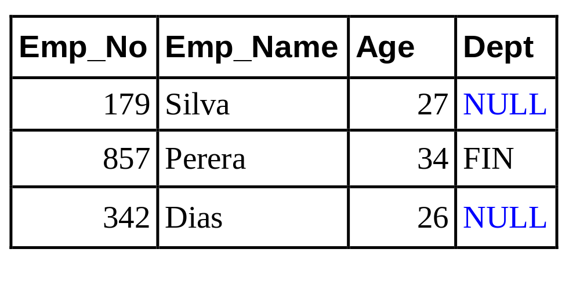
SET NULL DELETE
Department
×
Employee

Slide 43
SET DEFAULT DELETE
Delete with referential integrity
In Employee Table
CONSTRAINT Emp_Dep_FK
FOREIGN KEY (Dept) REFERENCES Department(Dept_Code) ON DELETE
SET DEFAULT ‘AAA’
DELETE FROM Department
WHERE Dept_Code = ‘SAL’
Deleting a department will result in changing the department of their employees in the employee table to a specified default value

Slide 44
SET DEFAULT DELETE
Department
×
Employee

